Slide 1
Brew Monday 2024
Tea party games pack
Notes:
Whether you’re planning to hold a Brew Monday event online or in person, we have created a few tea-themed activities to encourage people at your event to connect over a cuppa. Hopefully you’ll be able to use and adapt some of the ideas shared in this presentation to create a successful tea party event of your own.

Slide 2
Brew Monday 2024
This Brew Monday, 15 January, Samaritans is reminding everyone to reach out for a cuppa and a catch-up with the people you care about.
At Samaritans we know there’s no such thing as ‘Blue Monday’ – feeling low isn’t just something that happens on Mondays or in January.
So we say out with the blue and in with the brew!
There’s always time for a cuppa and a catch-up. It doesn’t matter if it’s a Monday morning or Saturday night, or if you’re drinking green tea, black coffee or orange juice.
If you’re sharing a cuppa and listening, you’re doing it right!
Notes:
This year we are reminding people that there’s always time for a cuppa and a catch-up. It doesn’t matter if it’s Monday morning or Saturday night, or if you’re drinking green tea, black coffee or orange juice. It doesn’t matter if you catch up in person, virtually or over the phone. If you’re sharing a cuppa and listening, then you’re doing it right.

Slide 3
Share a memory
1. Split into pairs (if you’re meeting virtually use breakout rooms)
2. Each person takes it in turns to share:
- Their favourite memory of sharing a cuppa with someone
- The person they most like to share a cuppa with and why
3. After 5 minutes, come back together as a group and take it in turns to share your partner’s memory with the group.
For example: 'This is *name* and their favourite memory was xxx because xxx.
Notes:
Let’s get listening! This activity is designed to help people make the time to get to know and listen to each other.

Slide 4
Brew Monday tea quiz
Test your knowledge with our Brew Monday tea trivia!
1. What per cent of the British population drink tea and herbal infusions every day?
A) 84% B) 50% C) 39%
2. How many cups of tea do Britain’s drink per year?
A) 1.6 million cups B) 36 billion cups C) 84 billion cups
3. 98% of people take their tea with milk, but what per cent takes sugar?
A) 15% B) 30% C) 60%
4. Globally, how many tons of tea is produced every year?
A) 1.6 billion tons B) 750,000 tons C) 2.9 million tons
Notes:
How well do your brew crew know their tea? Find out with our Brew Monday tea quiz.
Answer key:
A) 84%
B) 36 billion cups
B) 30%
C) 2.9 million tons

Slide 5
Brew Monday tea quiz
5. Approximately, how many known varieties of tea are there?
A) 987 B) 3,000 C) 1,500
6. What tea is referred to as the ‘Champagne of teas’ and is largely only grown in a 70 square mile area at the foot of the Himalayas?
A) Darjeeling tea B) Oolong tea C) Assam tea
7. How many tea leaves does it take to create one pound of finished black tea ?
A) 5,000 B) 10,000 C) 2,000
8. What is the number of recommended cups of tea to drink every day?
A) 6 B) 4 C) 2
9. Tea is a natural source of fluoride that can help protect against tooth decay.
A) True B) False
Notes:
Answer key:
C) 1,500
A) Darjeeling tea
C) 2,000
B) 4
A)True

Slide 6
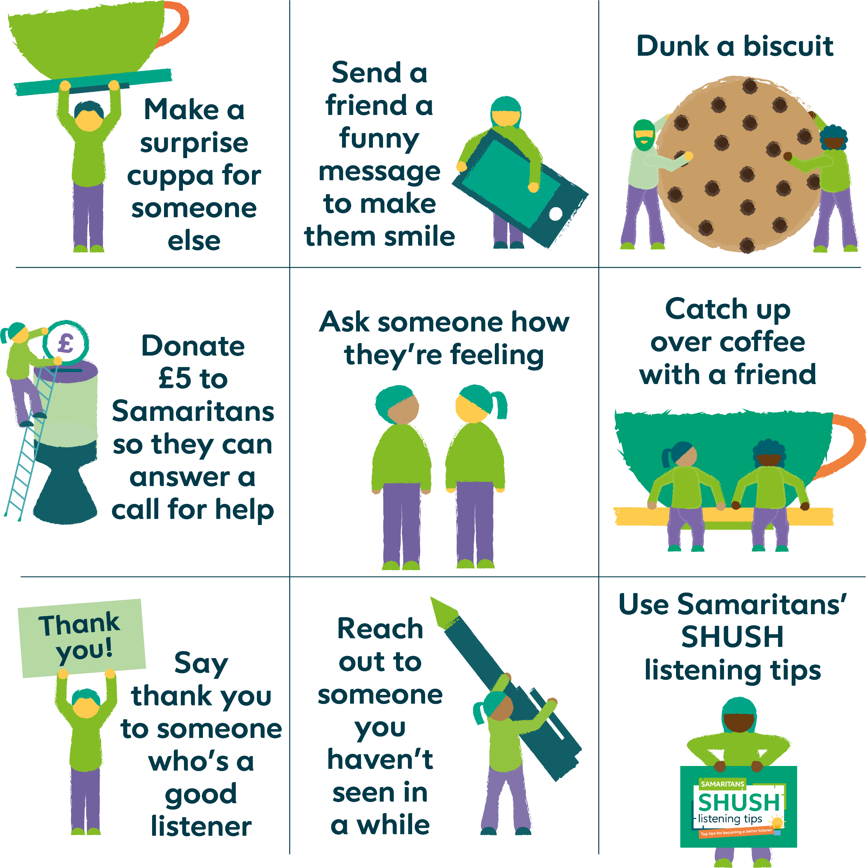
Brew Monday bingo
How many of these can you cross off today?
Notes:
Make Brew Monday last all day by encouraging people to play ‘Brew Monday bingo’ and see how many of these things they can cross off the list.

Slide 7
Help us be there when it matters most
By giving a donation or fundraising for Samaritans on Brew Monday, you’ll help make sure there’s always someone there for anyone who’s going through a tough time.
£5 could help Samaritans answer a call for help.
The quickest and easiest way to give a donation is online at: samaritans.org/brew-fundraising
Or you can simply text BREW to 70450 to make a £5 donation. You will be charged £5, plus one message at your standard network rate. Samaritans will receive 100% of your donation.
Notes:
By raising money at your Brew Monday event, you’re helping Samaritans be there for people who are going through a tough time.

Slide 8
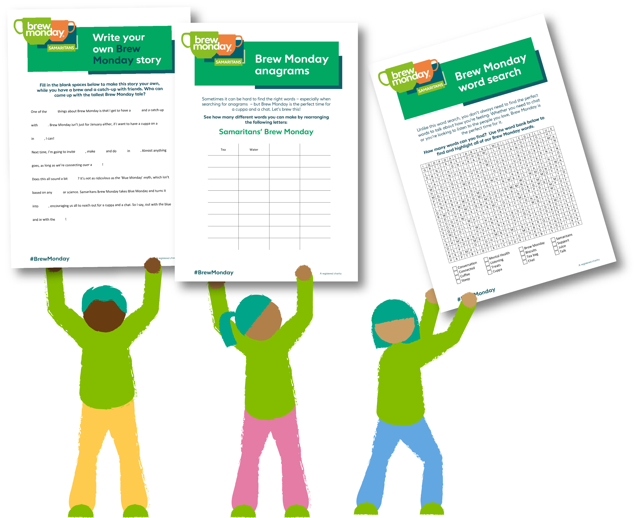
Downloadable activities
Still looking for more activities to make your Brew Monday the best ever?
We have some tea-rrific downloadable activity sheets on our website.
Try our Brew Monday anagram, do a Brew Monday word search or write your own silly Brew Monday story.
Visit our downloadable Brew Monday resources page for all of this and more.
Notes:
Head to our website for more downloadable Brew Monday activities.

Slide 9
Thank you!
Notes:
Thank you for connecting over a cuppa and supporting Samaritans!

