Slide 2
UPS AND DOWNS OF THE DAY
Video – Sam’s morning

Slide 3
UPS AND DOWNS OF THE DAY
Timeline – Sam’s day
Managed to
catch the bus
Friends waiting for Sam, planning to go to a gig.
Looking forward to basket ball match
Burnt toast and managed to trap cats tail in the door on the way out
In a rush for school thinking about gran who is poorly in hospital
Forgotten school bag

Slide 4
UPS AND DOWNS OF THE DAY
Timeline – my day

Slide 5
UPS AND DOWNS OF THE DAY
Audio clip – first aid box

Slide 6
UPS AND DOWNS OF THE DAY

Slide 7
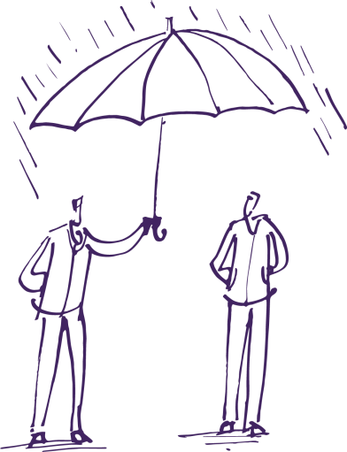
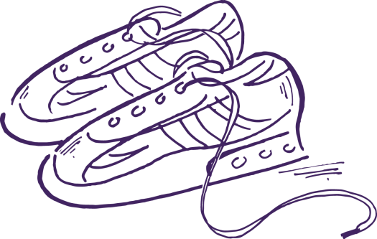
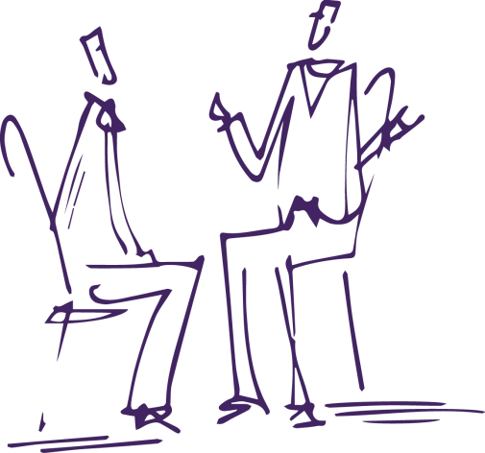
UPS AND DOWNS OF THE DAY
Notes:
Click to start animation

