Slide 2
DID YOU KNOW?
What are the issues for young people now?
In a 2014 (Health Behaviour in school age children PHE) report conducted in 6000 young people in England.
What percentage of 15 year olds reported they self harmed?
20%
How many young people under 18 received specialist treatment for alcohol or drug problems in 2012-13?
Approx. 10,000
Approx. 20,000
Approx. 30,000
20,032 young people – we continue to rank among the countries with the highest levels of consumption among those who do drink
Notes:
Click for answer then next question etc

Slide 3
DID YOU KNOW?
What are the issues for young people now?
How many children in every class in England aged 5-16 suffer from a diagnosable mental health disorder?
3
The Good Childhood Report 2013 states at which age is wellbeing at its lowest for young people (aged 15-17)?
15
There has been an increase in the number of young people being admitted to hospital because of self harm. Over the last ten years this figure has increased by:
27%, 53%, or 68%
68%
Notes:
Click for answer then next question etc

Slide 4
DID YOU KNOW?
Public Health England have found that:
Students with better health and wellbeing are likely to achieve more academically.
Effective social-emotional competencies are associated with greater health and wellbeing and better school performance.
School culture, ethos and environment influence student health and wellbeing and readiness to learn.
Student health and wellbeing influences, and is influenced by, measures of school effectiveness.

Slide 5
WHAT DO YOU THINK?
Please take time to discuss

Slide 6
WHAT YOUNG PEOPLE SAY
Video – Young people

Slide 7
WHY IS DEAL IMPORTANT?
Using the experience and expertise of Samaritans to promote awareness of emotional health in young people.
DEAL, Developing Emotional Awareness and Listening, is a set of free online resources for schools and colleges.
It was developed with young people, teachers and partner organisations.

Slide 8
WHAT IS DEAL?
Samaritans believe that educating young people about emotional health will result in improved wellbeing and health outcomes for young people.
It will mean more young people will access the support they need earlier, reducing potential mental health problems and ultimately reducing the numbers of suicides.

Slide 9
WHO WAS INVOLVED?
Design and development
The original DEAL resources, which have been widely used across the UK and Ireland were reviewed by over 160 individuals who were volunteers, teachers or other educational professionals.
Over 30 schools, youth organisations and educational professionals have seen and trialled various components of the new resource.
Young people designed and created the audio-visual resources and commented on the content of the activities.

Slide 10
THE AIMS OF DEAL ARE TO
Raise awareness of emotional health and the importance of recognising when you need help.
Develop help-seeking behaviour and skills.
Develop positive coping strategies.
Reduce stigma and barriers to talking about emotional health.

Slide 11
WHAT IS IN DEAL?
The resources are designed to be flexible and easily adaptable to meet varying curriculum demands and most importantly, the needs of students.
The activities are set out in four units:
Emotional health
Coping strategies
Connecting with others
Dealing with feelings
Activities are tailored to 20 minute tutorials and full hour long sessions. There are also video and audio resources and teachers notes to accompany the resources.

Slide 12
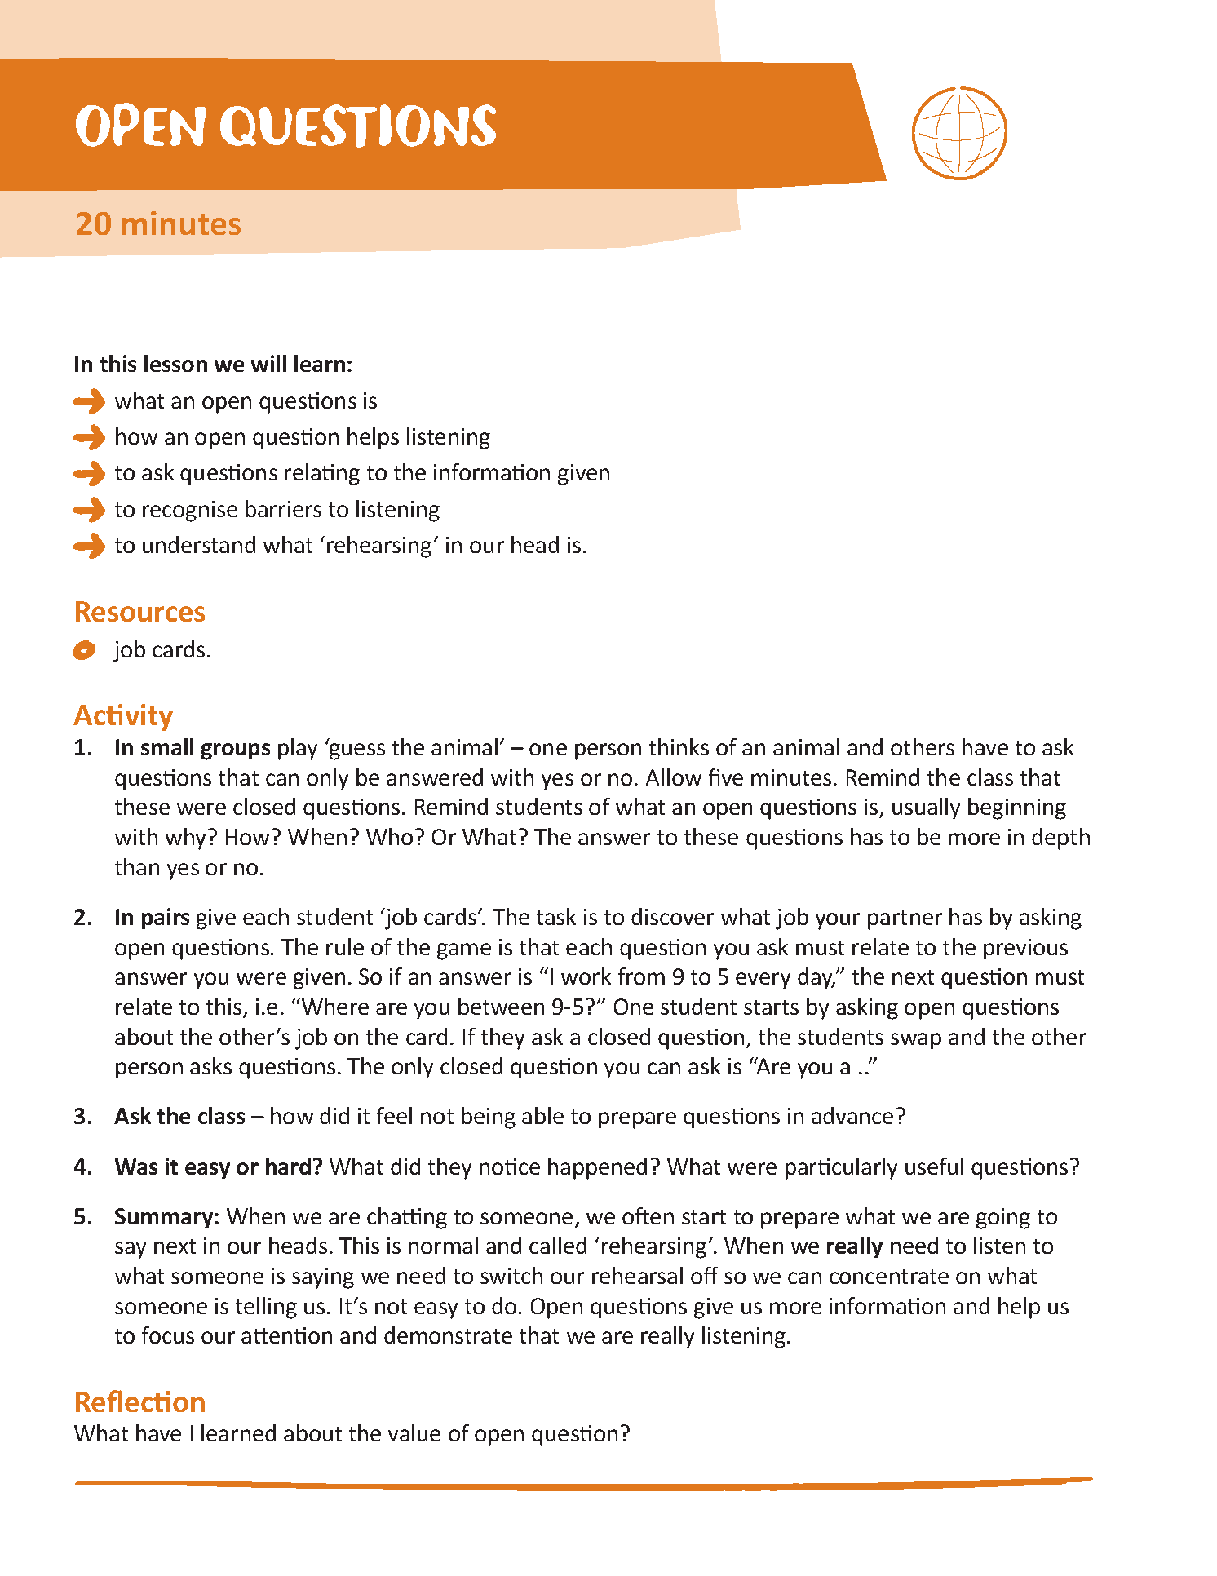
WHAT IS IN DEAL?
Example of session
PDF

Slide 13
WHAT IS IN DEAL?
Example of session – hand out
PDF

Slide 14
WHAT IS IN DEAL?
Example of web page

Slide 15
WHAT YOUNG PEOPLE SAY
“It can give people the courage to ask for help and know they are not alone.”
“It can impact on people who need help.”
“I learned something valuable in each session.”
“I learned to always speak to someone and don’t hold your feelings in.”

Slide 16
DEAL ONLINE
Website
www.samaritans.org/deal

