Slide 2
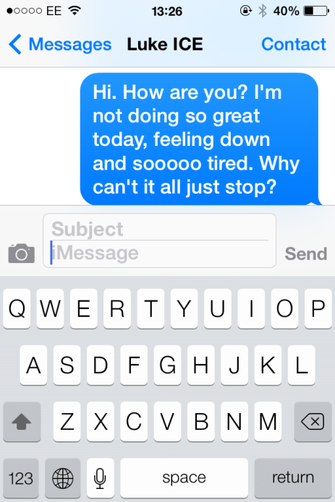
MAKING ASSUMPTIONS
Text

Slide 3
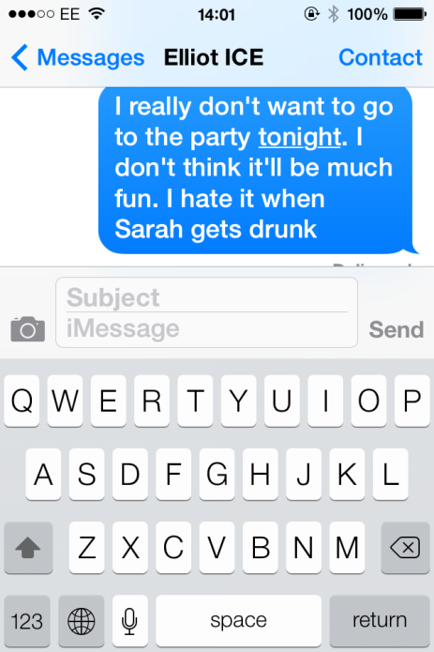
MAKING ASSUMPTIONS
Text

Slide 4
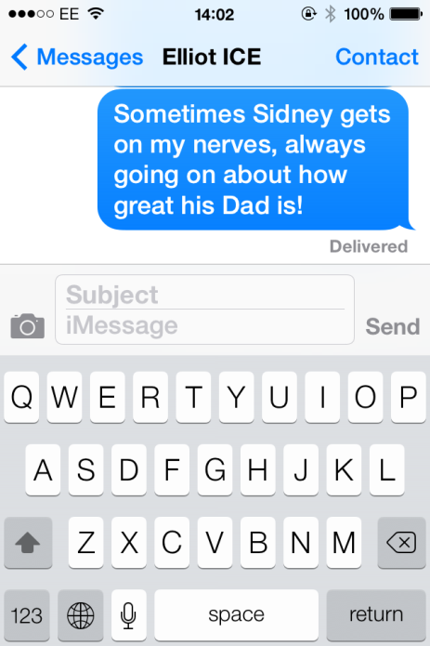
MAKING ASSUMPTIONS
Text

Slide 5
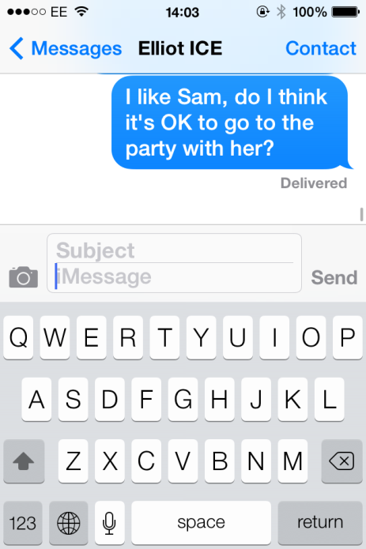
MAKING ASSUMPTIONS
Text

Slide 6
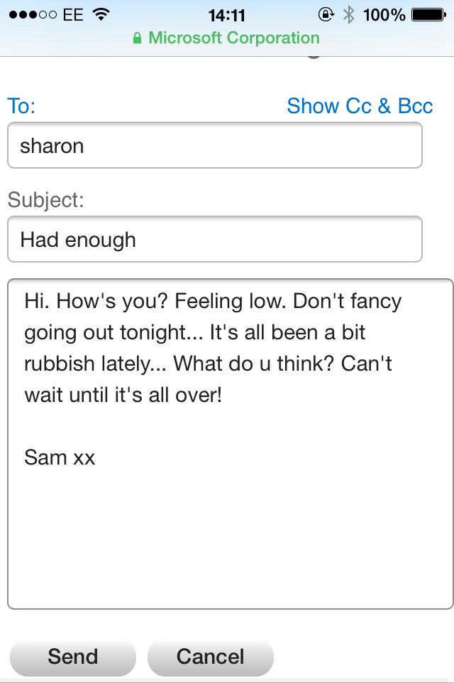
MAKING ASSUMPTIONS
Email

Slide 7
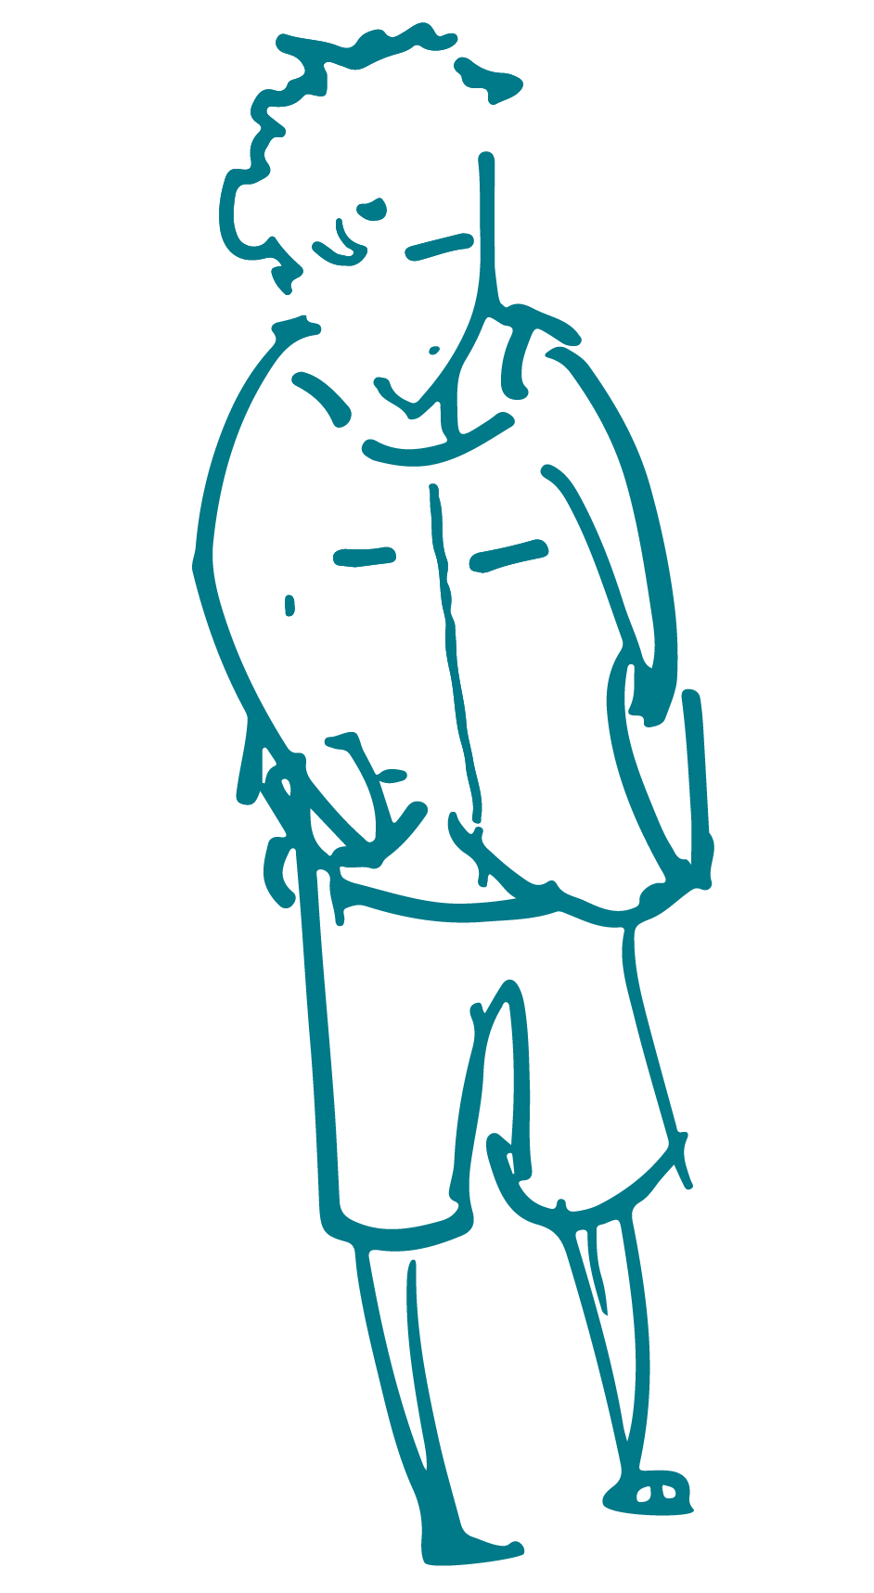
MAKING ASSUMPTIONS
Audio
Notes:
Slide to go with Audio clip 1 – a boy has been to knock for his friend who gives some evasive answers

Slide 8
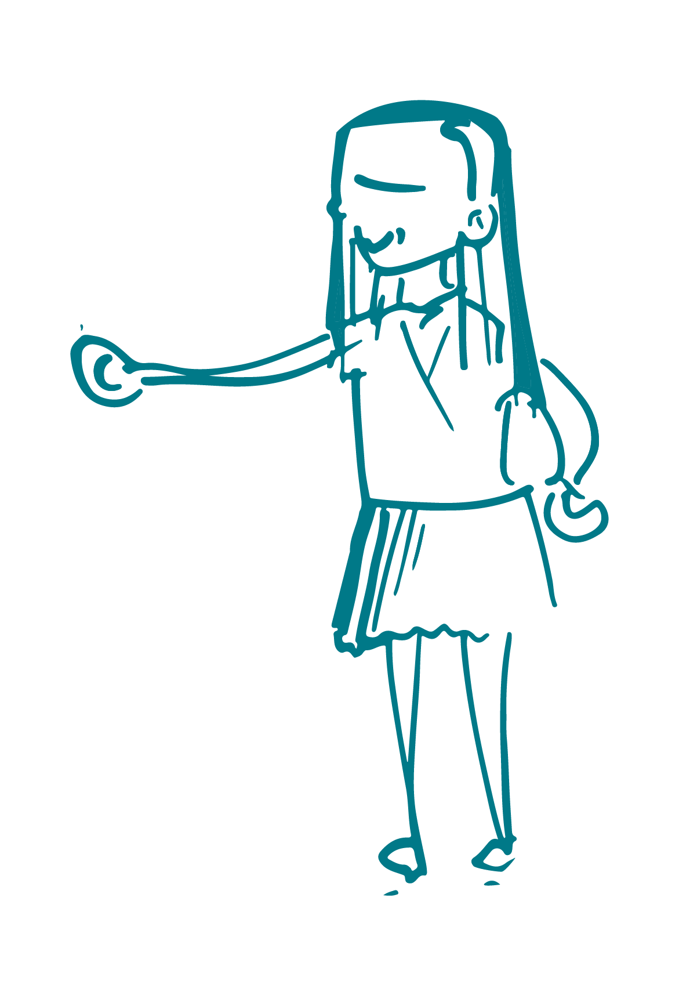
MAKING ASSUMPTIONS
Audio
Notes:
Slide to go with Audio clip 2 – girls chatting about parents

