Slide 2
MY SUPPORT NETWORK
Doctor
Teacher
ME
Childline
Samaritans

Slide 3
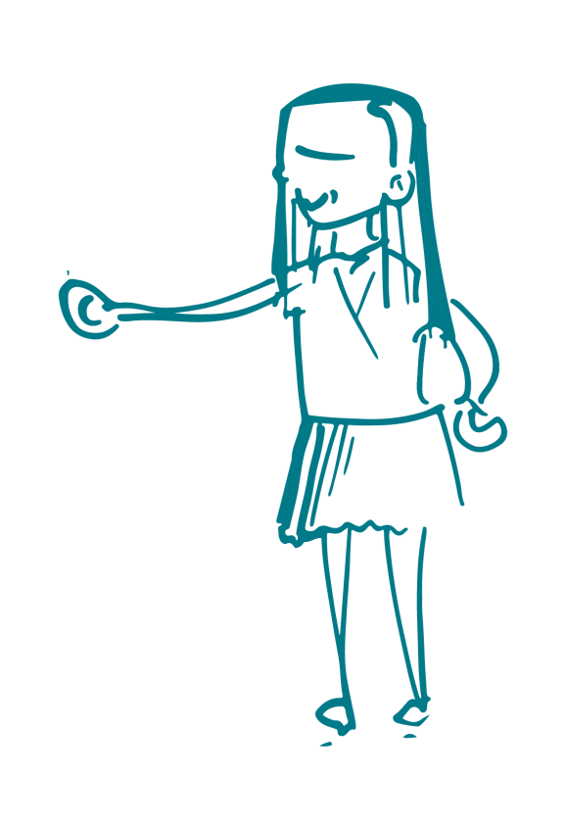
MY SUPPORT NETWORK
Audio clip – My story - Grace

