Slide 1
DRAFT
Notes:
DEAL is a free web based resource for professionals who work with young people

Slide 2
DID YOU KNOW?
What are the issues for young people now?
2014 (Health Behaviour in school age children PHE)
What percentage of 15 year olds reported they self-harmed?
10% 20% 30%
According to most recent national statistics, in a class of 30 children how many will have a diagnosable mental health disorder?
1 2 3 7 10
Notes:
These questions are taken from the 2014 report ( health behaviour in school age children, Public Health England)

Slide 3
DID YOU KNOW?
What are the issues for young people now?
According to The Good Childhood Report 2013 states at which age is wellbeing at its lowest for young people (aged 15-17)?
15
According to a recent Young Minds report , what % of young people said they don’t know how to look after their mental health?
20% 40% 70% 80%
Notes:
1 in 3 young people said they did not know where to go to get help and 69% said stigmas stopped them from talking to a friend about mental health problems. ( Young Minds vs campaign report 2013)
(Young Minds 2014)

Slide 4
DID YOU KNOW?
What are the issues for young people now?
What % people will experience suicidal thoughts throughout their lifetime?
5 % 9% 17 % 39 %
What is the gap in time between the first signs of a mental health problem in a child to that person receiving treatment?
3 months 6 months 1 year 5 years 10 years
Notes:
Click for answer then next question etc

Slide 5
DID YOU KNOW?
What are the issues for young people now?
How long is the average time someone takes to tell family and friends about a mental health problem?
3 months 6 months 8 months over a year
In 2014, the number of young people aged 10-19 who took their own life in England was recorded as:
37 79 166 201
Notes:
Samaritans usually talk in rates per population , as figures can be misleading. This is a rate of approx. 4.4 per 100,000
Young people do not die at the same rate as older people. Nevertheless. It is shocking and why we feel it is so important to make sure young people know that they can seek help, where from and how.

Slide 6
DID YOU KNOW?
Public Health England have found that:
Students with better health and wellbeing are likely to achieve more academically.
Effective social-emotional competencies are associated with greater health and well-being and better school performance.
School culture, ethos and environment influence student health and well-being and readiness to learn.
Student health and wellbeing influences, and is influenced by, measures of school effectiveness.
Notes:
Reference Public health report 2014

Slide 7
WHAT DO YOU THINK?
Please take time to discuss
Notes:
Encourage the group to discuss and feedback thought.

Slide 8
WHAT IS DEAL?
Using the experience and expertise of Samaritans to promote awareness of emotional health in young people.
DEAL, Developing Emotional Awareness and Listening, is a set of free web-based resources for schools and colleges.
It was developed with young people, teachers and partner organisations.

Slide 9
WHO WAS INVOLVED?
Design and development
The original DEAL resources, which have been widely used across the UK and Ireland were reviewed by over 160 individuals who were volunteers, teachers or other educational professionals.
Over 30 schools, youth organisations and educational professionals have seen and trialled various components of the new resources.
Young people designed and created the audio-visual resources and commented on the content of the activities.

Slide 10
WHY USE DEAL?
Samaritans believe that educating young people about emotional health, and the importance of seeking help when it is needed, will result in improved well-being and health outcomes for young people.
Samaritans believe that education about emotional health will mean that more young people will access the support they need earlier. This should help to reduce potential mental health problems and enhance the wellbeing of young people. That is why DEAL was developed to help educators in their efforts to develop resilience in young people and promote emotional health and wellbeing.
Notes:
I think we would all agree that :
School culture, ethos and environment influence student health and well-being and their readiness to learn
It is important for schools to sustain and enhance the emotional health, well-being and resilience of young people
Students with better emotional health and well-being are likely to achieve more at school

Slide 11
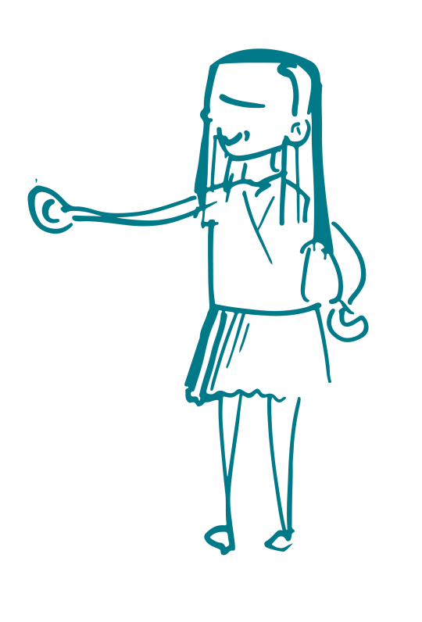
THE AIMS OF DEAL :
Raise awareness of emotional health and the importance of recognising when you need help.
Develop help-seeking behaviour and skills.
Develop positive coping strategies.
Reduce stigma and barriers to talking about emotional health.
www.samaritans.org/deal
Notes:
You will see that DEAL aims to:
raise awareness of emotional health and the importance of recognising when you need help
develop positive coping strategies
develop communication skills
develop supportive and help-seeking behaviour in young people.
These sessions aim to help to reduce stigma and break down the barriers around talking about emotional health.
DEAL contains plans for group lessons which last about an hour, and also some additional activities of about 20 minutes.
Each plan has everything needed for its delivery, including full teacher’s notes, a list of all resources, work sheets, handouts and video or audio clips.
Some sessions deal with difficult issues, but there is a strong emphasis on coping strategies and seeking help when needed.

Slide 12
ACCESSING THE RESOURCE
Go to www.samaritans.org/deal
You will reach a page showing an overview of the themes.
Notes:
You will reach a registration page. Register your details if you haven't done this before and click to go to resources

Slide 13
WHAT IS IN DEAL?
The activities are set out in four themes. You can click on a theme heading to bring up all of the activities within each theme.
Emotional health
Coping strategies
Connecting with others
Dealing with feelings
Activities are 20 minute or 60 minute long sessions. There are also video and audio clips and teachers notes to accompany the resources.

Slide 14
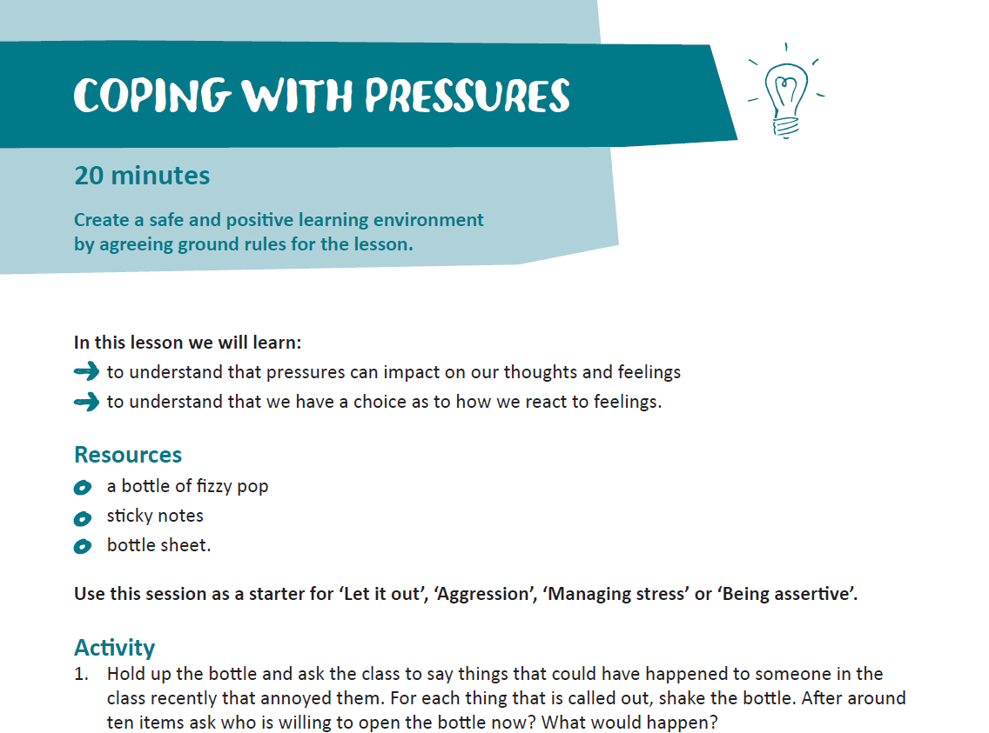
WHAT IS IN DEAL?
Example of session
PDF
Notes:
This lesson plan gives everything you need to run the session : aims, resources and any video clips or handouts needed in a session would be included here as well.
All lesson outlines can be downloaded or opened as a webpage.
You can watch videos by clicking on the links and playing them through Youtube or downloading them before hand.

Slide 15
WHAT IS IN DEAL?
Example of digital resources
Notes:
This is a screen shot from our ‘’Hope” animation created and produced with young people for young people.

Slide 16
WHAT YOUNG PEOPLE SAY
“It can give people the courage to ask for help and know they are not alone.”
“It can impact on people who need help.”
“I learned something valuable in each session.”
“I learned to always speak to someone and don’t hold your feelings in.”
Notes:
This is some of the feedback we have had from young people who have experiences some of the DEAL activities.

Slide 17
DEAL ONLINE
Website
www.samaritans.org/deal
Notes:
Please tell us what you think of DEAL, on the website there are opportunities to send us your feedback.
Thankyou for listening!

