Slide 1
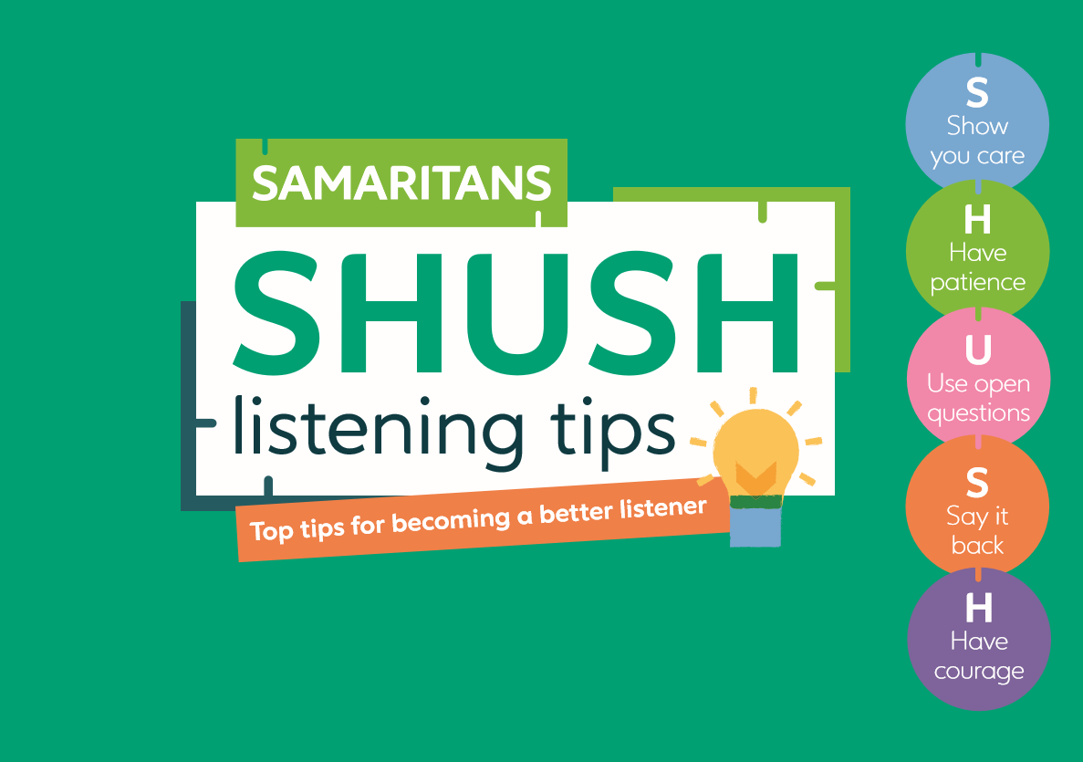
Notes:
“I’d like to share some Samaritans listening tips with you; they have a nice easy acronym – SHUSH – to help us remember them… and to help us remember to listen more than talk too!”
“Show you care. Focus on the other person; give them your full attention; stay present and manage and – if you feel the perfectly naturally urge to interrupt or talk – try to replace it with listening sign such as nodding your head or saying just a short word to encourage the other person to keep talking – e.g. “go on” “tell me more about that.”
“Have patience. As we said before, it may take time and several attempts before a person is ready to open up. Time is key. The person sharing shouldn’t feel rushed, or they won’t feel it’s a safe environment. If the other person has paused, wait. They may not have finished speaking. Remember that it might take them some time to think through what they wat to say or they may find it difficult to express how they are feeling in words.”
“Use open questions that need more than a yes/no answer, and follow up e.g. ‘Tell me more’ or ‘How did that affect you?” These questions are objective and require a person to pause, think, reflect and then hopefully expand. Be cautious of questions that start with WHY – e.g. Why did you do that? What didn’t you speak to someone as they can come across as critical or judgemental.
“Say it back to check you’ve understood – and show the other person you’re listening and WANT to understand. Repeating something back to somebody (in their words not your own) is a good way to reassure them that they have your undivided attention. You can check to see that you’re hearing what they want you to hear, not putting your own interpretation on the conversation – e.g. “You said that you’re finding it hard to manage your job, childcare and support your mum” rather than “You said you’re struggling to cope with multiple priorities.”
“Have courage. Don’t be put off by an initial negative response and don’t feel you have to fill a silence in a conversation. Show you’re willing to listen – sometimes just kindness and patience are exactly what somebody needs to be able to share what is going on for them.”
Note: Prompt for any questions/comments on the SHUSH Tips.
“Active listening is a skill, and it takes practice; but don’t give up and remember you can only do your best. Supporting someone can be challenging in itself. If you're helping someone who’s struggling to cope, make sure you take care of yourself as well.
TRANSITION: “Let’s recap what we’ve covered today…”

