Slide 2
SELF-HARM MYTHS AND FACTS
Dear diary
Dear Diary
I have been hurting myself again today. It’s been three months now. It has made me feel so ashamed and even worse than I did before. I want to scream and shout but I will get into trouble if I do that, so instead I do this because it is quiet and no one will know. I’m sitting in the bathroom.
I never had any friends before cos I was bullied and now I feel even more ashamed because I hurt myself so I don’t have any friends now and I can’t tell anyone about it.
They wouldn’t understand anyway. No one does. I don’t know how else to cope with what’s going on. If anyone finds out I’ll be in so much trouble. I wish I could stop this.
Sam

Slide 3
SELF-HARM MYTHS AND FACTS
My support network
Doctor
Teacher
ME
Childline
Samaritans

Slide 4
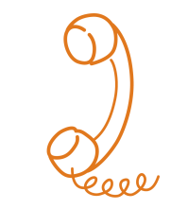
SELF-HARM MYTHS AND FACTS
Organisations
thesite.org
harmless.org.uk
youngminds.org.uk
rcpsych.ac.uk
samaritans.org
nspcc.org
bemindful.co.uk
Samaritans 116 123
Childline 0800 11 11

